Slide 1
A Deeper Look into Sarcastic Tweets Using Deep Convolutional Neural Networks Soujanya Poria, Erik Cambria, Devamanyu Hazarika, Prateek Vij
Xihao Liang

Slide 2
Background
Sarcasm detection is a key task for many natural language processing tasks.
In sentiment analysis, for example, sarcasm can flip the polarity of an “apparently positive” sentence and, hence, negatively affect polarity detection performance.
requires a deeper understanding of natural language that standard text categorization techniques cannot grasp

Slide 3
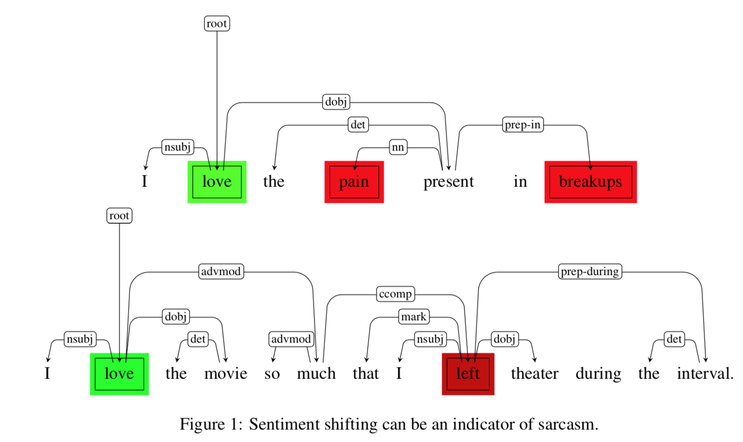
background

Slide 4
Background
non-sarcastic sentences provided the classifier with the ground-truth polarity of those events, which the classifier could then contrast with the opposite estimations in sarcastic sentences.
Twitter is a more suitable resource because the polarity of short tweets is easier to detect (as all the information necessary to detect polarity is likely to be contained in the same sentence)

Slide 5
Main Contribution
To the best of our knowledge, this is the first work on using deep learning for sarcasm detection.
Unlike other works, we exploit sentiment and emotion features for sarcasm detection. As user profiling is also an important factor for detecting sarcastic content, moreover, we use personality-based features for the first time in the literature.
Pre-trained models are commonly used in computer vision. In the context of natural language processing (NLP), however, they are barely used. Hence, the use of pre-trained models for feature extraction is also a major contribution of this work.

Slide 6
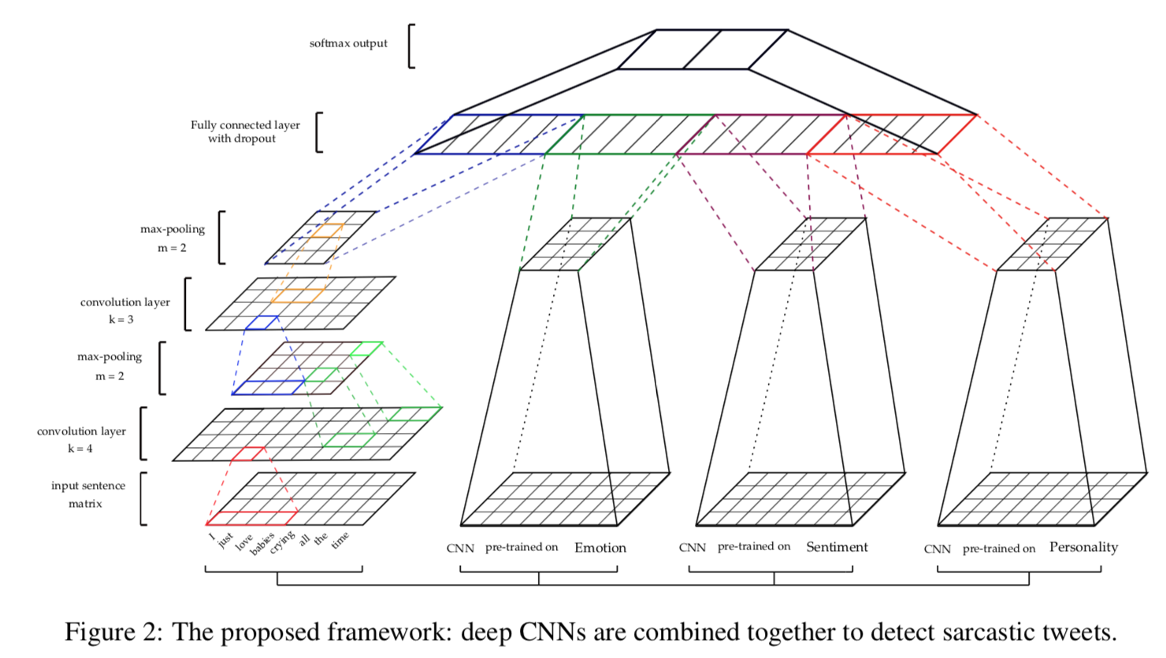
Framework

Slide 7
Models
Baseline model
Dataset 1 (Balanced Dataset)
This dataset was created by (Pta ́cek et al., 2014)
downloaded from Twitter using #sarcasm as a marker for sarcastic tweets
a balanced distribution of 50,000 sarcastic tweets and 50,000 non-sarcastic tweets.
Dataset 2 (Imbalanced Dataset)
English dataset from (Pta ́cek et al., 2014)
It consists of 25,000 sarcastic tweets and 75,000 non-sarcastic tweets.
Dataset 3 (Test Dataset)
dataset from The Sarcasm Detector2
20,000 are sarcastic and 100,000 are non-sarcastic

Slide 8
Models
Sentiment Feature Extraction Model
Semeval 2014 (Rosenthal et al., 2014) Twitter Sentiment Analysis Dataset
positive / negative / neutral
Emotion Feature Extraction Model
corpus developed by (Aman and Szpakowicz, 2007)
Anger / Disgust / Surprise / Sadness / Joy / Fear
blog posts were split into sentences and each sentence was labeled
Personality Feature Extraction Model
five personality traits described by (Matthews and Gilliland, 1999)
Openness / Conscientiousness / Extraversion / Agreeableness / and Neuroticism
sometimes abbreviated as OCEAN
we create a CNN for each personality trait and the aim of each CNN is to classify a sentence into binary classes, i.e., whether it expresses a personality trait or not.

Slide 9
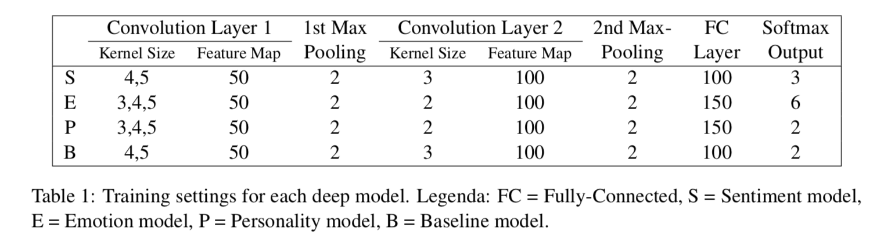
Models

Slide 10
Word Embeddings
100 billion words from Google News
The vectors are of dimensionality 300
common presence of informal language and words in tweets resulted in a relatively high random initialization of word vectors due to the unavailability of these words in the word2vec dictionary
non-static representations during training

Slide 11
Merging the features
In the standard feature merging process, we first extract the features from all deep CNN based feature extraction models and then we concatenate them. Afterwards, SVM is employed on the resulted feature vector.
In another setting, we use the features extracted from the pre-trained models as the static channels of features in the CNN of the baseline method. These features are appended to the hidden layer of the baseline CNN, preceding the final output softmax layer.

Slide 12
Pre-processing
identified and removed all the “user”, “URL” and “hashtag” references present in the tweets using efficient regular expressions
used NLTK Twitter Tokenizer to ensure proper tokenization of words along with special symbols and emoticons

Slide 13
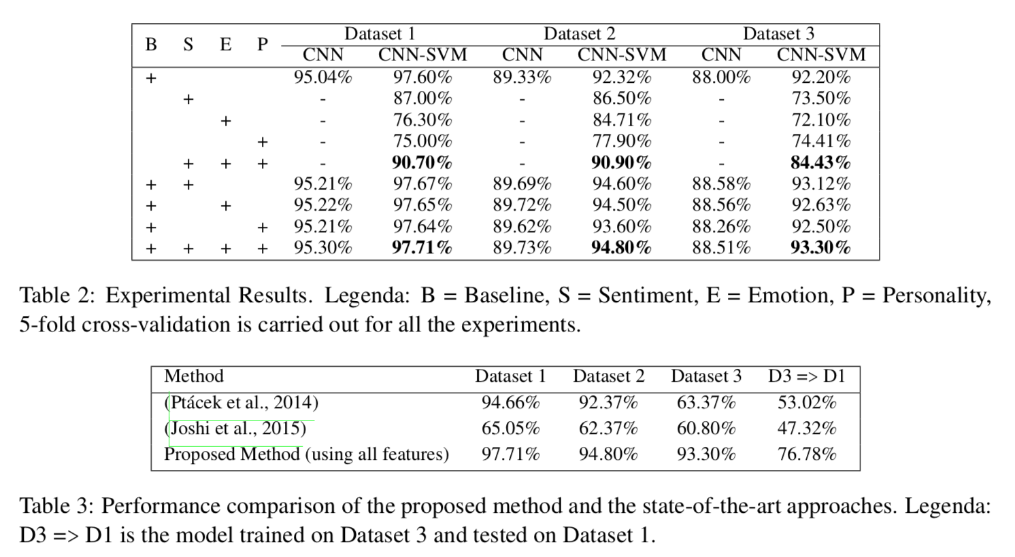
Experiment Result

Slide 14
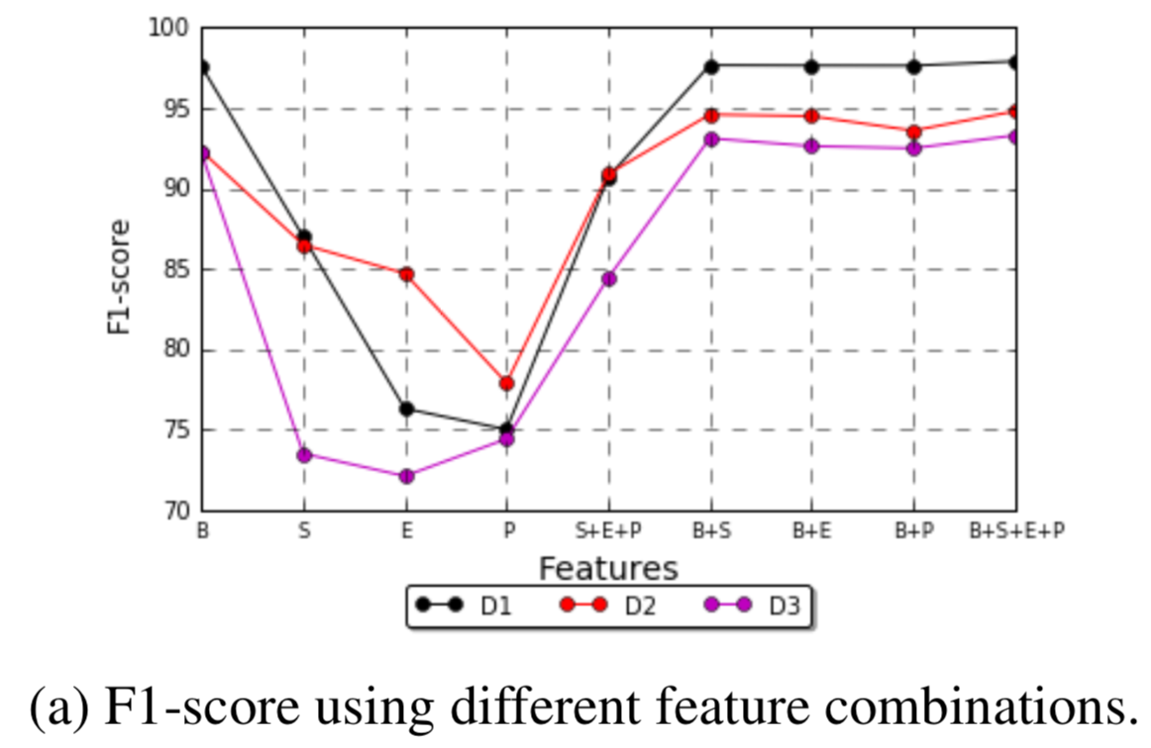
Discussions
sarcasm is very much topic-dependent and highly contextual
“I am so glad to see Tanzania played very well, I can now sleep well :P”
a highly positive statement which ends with a emoticon expressing joke can be sarcastic
sentiment and emotion features are the most useful features, besides baseline features

Slide 15
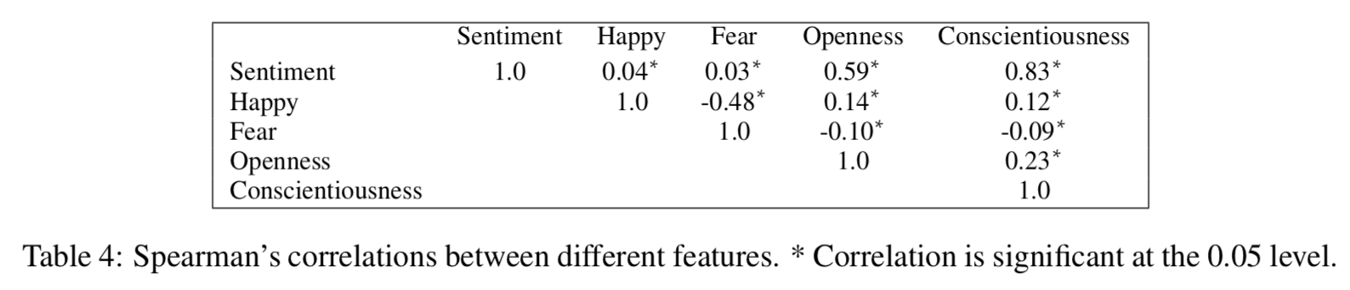
Discussions
In order to reach a better understanding of the relation between personality features among themselves and with other pre-trained features, we carried out Spearman correlation testing. Results, displayed in Table 4, show that those features are highly correlated with each other.

Slide 16
Future Work
evaluate the performance of the proposed method on a large corpus and other domain-dependent corpora
focus on analyzing past tweets and activities of users in order to better understand their personality and profile

